Slide 1
Finding MST-Kruskal’s Algorithm
CSE 2202: Algorithm Analysis and Design Laboratory
Most. Kaniz Fatema Isha
Md Mehrab Hossain Opi

Slide 2
Background
A spanning tree is defined as a tree-like subgraph of a connected, undirected graph that includes all the vertices of the graph.
A minimum spanning tree (MST) is defined as a spanning tree that has the minimum weight among all the possible spanning trees.

Slide 3
Characteristics
Same vertices: The spanning tree has the same number of vertices (V) as the original graph.
Edges: The spanning tree has 𝐸 = 𝑉−1 edges, where V is the number of vertices.
Connected: The spanning tree must be connected, with only one component.
Acyclic: The spanning tree cannot have any cycles.
Total cost: The cost (or weight) of the spanning tree is the sum of its edge weights.
Multiple trees: A graph can have several possible spanning trees.

Slide 4
Kruskal’s Algorithm
Kruskal’s algorithm to find the minimum cost spanning tree uses the greedy approach.
Algorithm steps:
Sort all the edges in non-decreasing order of their weight.
Pick the smallest edge. Check if it forms a cycle with the spanning tree formed so far. If the cycle is not formed, include this edge. Else, discard it.
Repeat step#2 until there are (V-1) edges in the spanning tree.

Slide 5
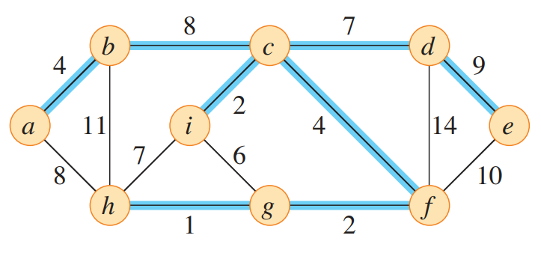
Kruskal’s Algorithm
Kruskal’s algorithm to find the minimum cost spanning tree uses the greedy approach.

Slide 6
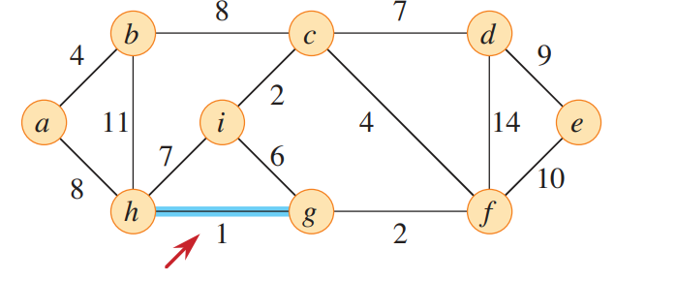
Kruskal’s Algorithm

Slide 7
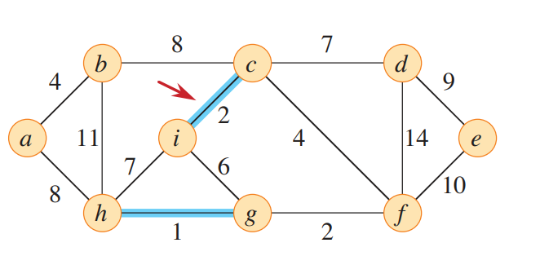
Kruskal’s Algorithm

Slide 8
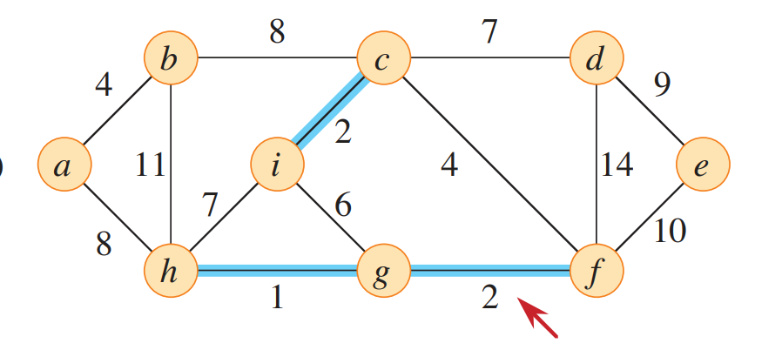
Kruskal’s Algorithm

Slide 9
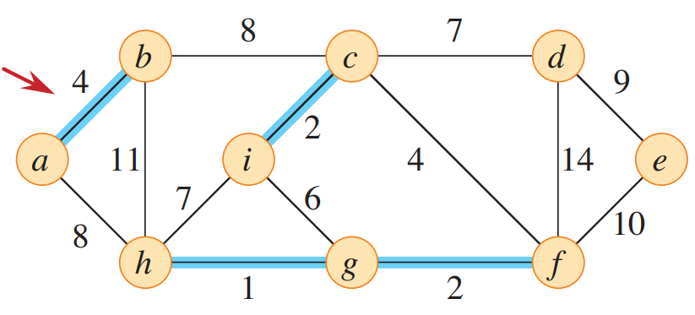
Kruskal’s Algorithm

Slide 10
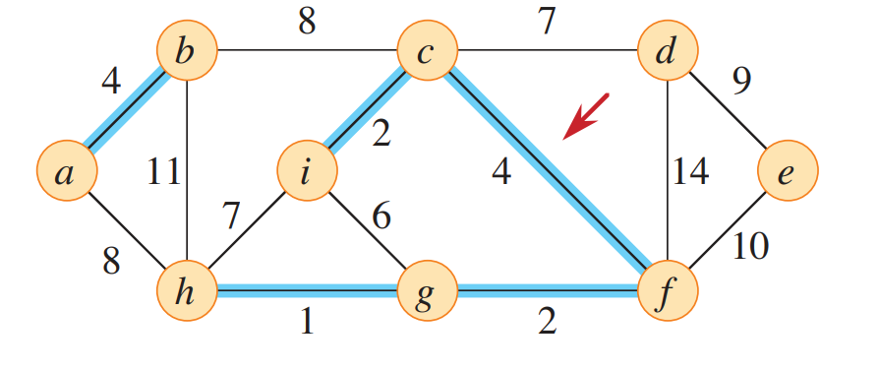
Kruskal’s Algorithm

Slide 11
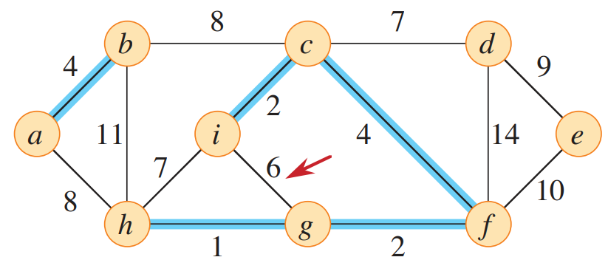
Kruskal’s Algorithm

Slide 12
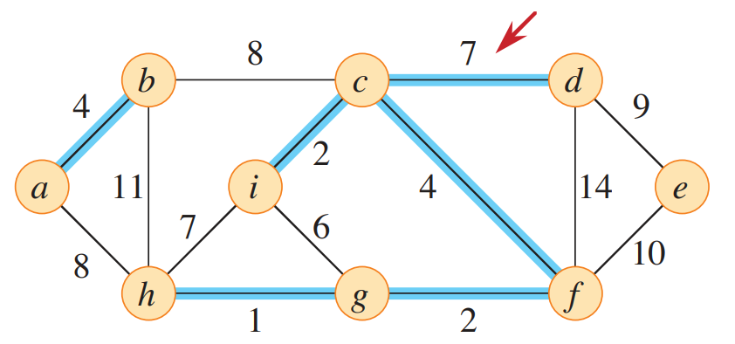
Kruskal’s Algorithm

Slide 13
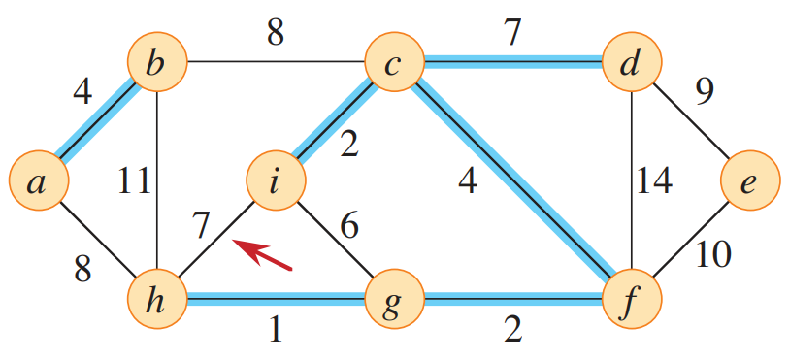
Kruskal’s Algorithm

Slide 14
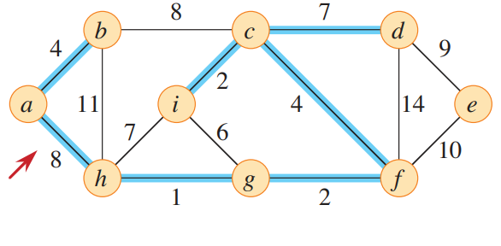
Kruskal’s Algorithm

Slide 15
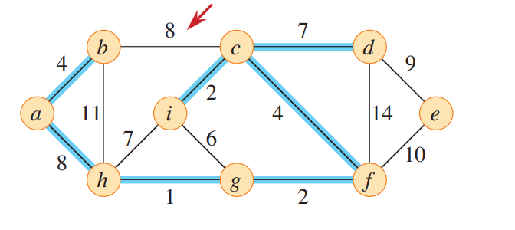
Kruskal’s Algorithm

Slide 16
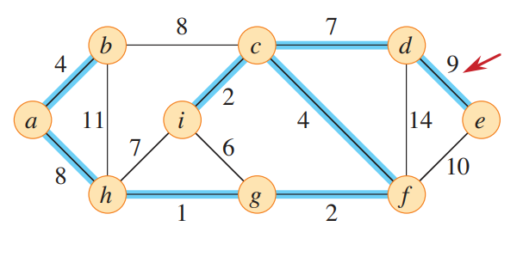
Kruskal’s Algorithm

Slide 17
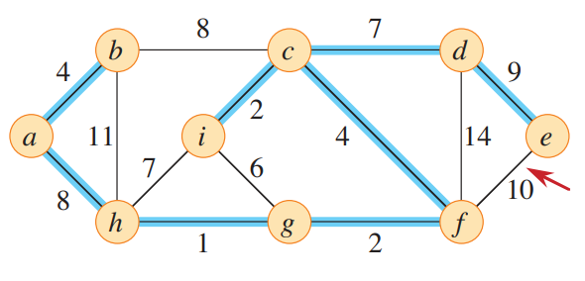
Kruskal’s Algorithm

Slide 18
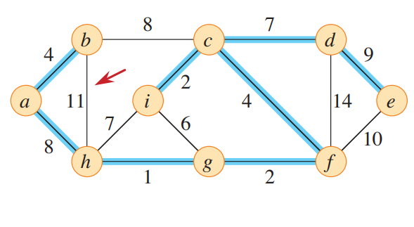
Kruskal’s Algorithm

Slide 19
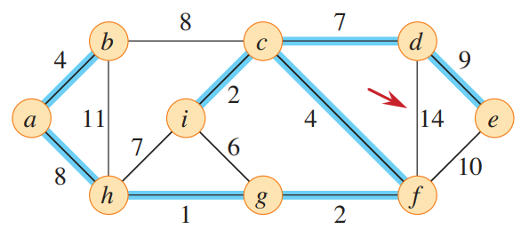
Kruskal’s Algorithm

Slide 20
Kruskal’s Algorithm
For cycle detection, this algorithm uses Union- Find algorithms.
For each edge, the algorithm checks if the vertices of the edge belong to different sets using the Find operation.
If they are in different sets, it adds the edge to the MST.
It uses Union to merge the sets of the two vertices so that they are considered part of the same connected component.

Slide 21
Kruskal’s Algorithm
For example, If we have vertices A, B, and C, and an edge between A and B, the Union operation will merge the sets containing A and B. The Find operation will ensure no cycles are formed by checking if A and B are already in the same set.

Slide 22
What happens in a directed graph?
1
2
A
B
D
4
1
C

Slide 23
Time Complexity
Sorting of edges takes O(E * logE) time.
The find and union operations can take at most O(logV) time. So, it becomes O(E logV)
Overall complexity is O(E * logE + E * logV) time.
The value of E can be at most O(V²), so O(logV) and O(logE) are the same. Therefore, the overall time complexity is O(E * logE) or O(E*logV)

Slide 24
References
Introduction to Algorithm, 4th ed, Leiserson, Charles Eric, Ronald L. Rivest, Thomas H. Cormen, and Clifford Stein.
https://www.geeksforgeeks.org/kruskals-minimum-spanning-tree-algorithm-greedy-algo-2/

